Slide 1
Infectious disease modelling course Workshop 6a – Fitting dynamic transmission models to real hospitalization data
10 March 2021
By the GeMVi modelling team

Slide 2
Workshop outline
Model development: gathering and visualizing influenza hospitalization data from the USA, and choosing transmission models to fit to data.
Observation model: what can be observe about infectious disease spread?
Error/loss functions: how different is your current best estimate from the real data?
Numerical optimization: how to improve your estimates.
Model Selection: which model is the best supported by the data?

Slide 3
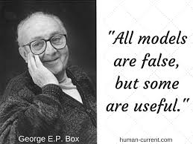
Motivation
So far we have mainly looked at transmission models from a theoretical point of view because the mechanistic arguments behind transmission models are plausible and, therefore, we expect that the behaviour of theoretical models gives insight into the real behaviour of epidemics.
In this workshop, we revisit estimation from data (see workshop 2):
We will test the compatibility of epidemic models with real epidemic data over an influenza season.
We will estimate theoretically important quantities like R₀ from the season of influenza data.

Slide 4
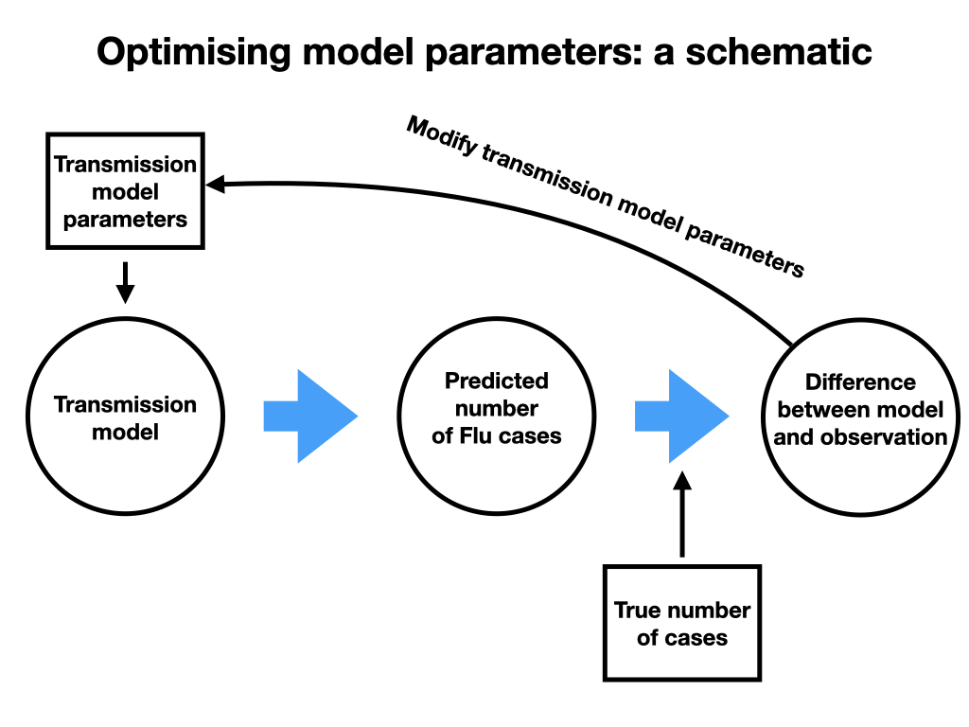
High-level view of parameter inference for epidemic models

Slide 5
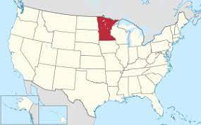
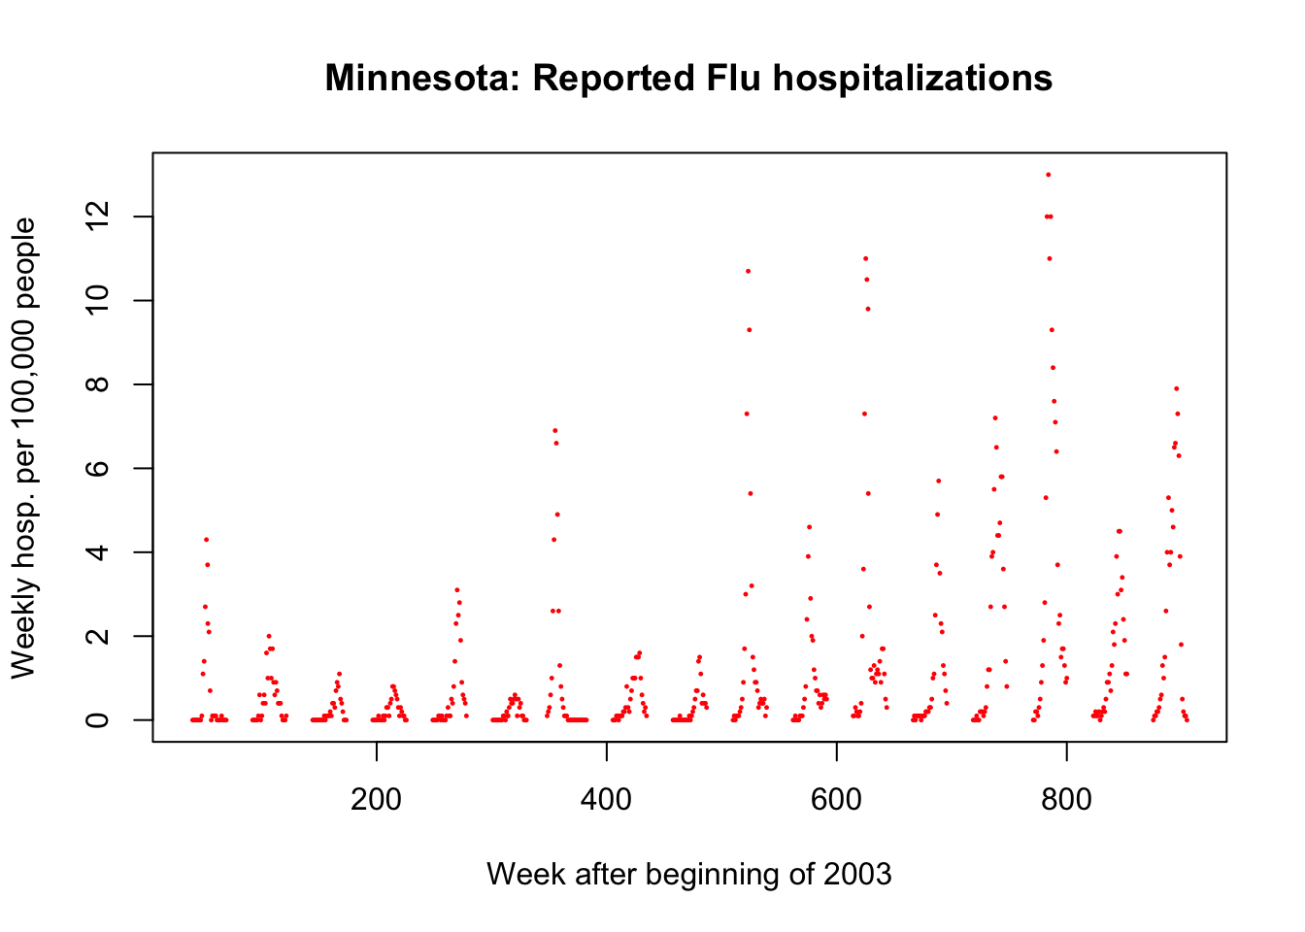
Influenza hospitalization data
CDC influenza surveillance covers around 55% of the population of Minnesota state.
They report hospitalization for influenza, with confirmatory test, as weekly incidence per 100,000 people in surveillance population.
We will focus on the 2017-2018 influenza season.
Data runs for 30 weeks in the influenza season (week 1 starts 2nd Oct 2017).
https://www.cdc.gov/flu/weekly/influenza-hospitalization-surveillance.htm

Slide 6
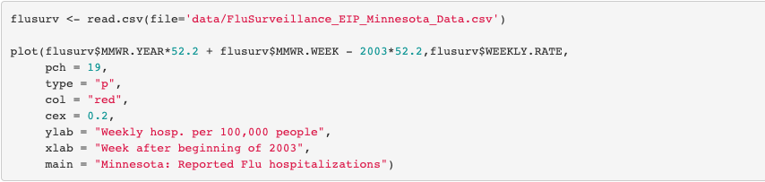
Try yourself…
https://www.cdc.gov/flu/weekly/influenza-hospitalization-surveillance.htm

Slide 7
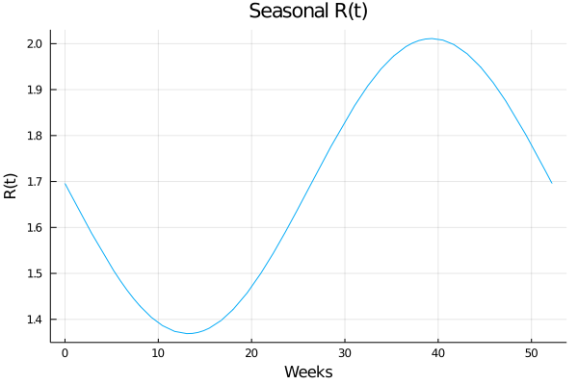
Choosing transmission models to fit to influenza data: Seasonality
For models without seasonality:
fix xi = 0.

Slide 8
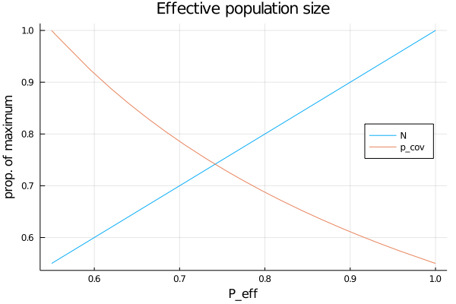
Choosing transmission models to fit to influenza data: Population size
Does CDC surveillance represent a sub-sample of a Minnesotan epidemic or the whole sample of a local epidemic?

Slide 9
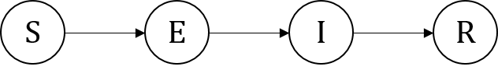
Basic influenza transmission model
We consider 4 variants of the model:
Full model
Seasonal model with P_{eff} = 1 (state-wide transmission model).
Seasonal model with P_{eff} = 0.55 (local CDC surveillance area model).
Non-seasonal model with P_{eff} = 1.

Slide 10
Try yourself…
Can you run the code for the seasonal influenza model? What about trying a redefined R_t function?

Slide 11
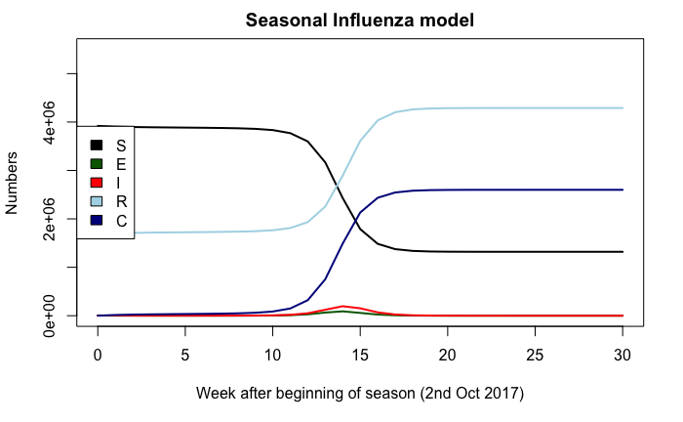
Visualizing a set of guessed parameters
Some of the parameter for the basic influenza model can be found in the literature… but a lot can’t.
Also, how do we relate the SEIR solution to the actual data?

Slide 12

Observation model
What is the chance that someone who gets infected enters our data set?
Probability this is in
CDC surveillance area
Infected in week n
Develop symptoms
Visit hospital
Get tested
Probability

Slide 13
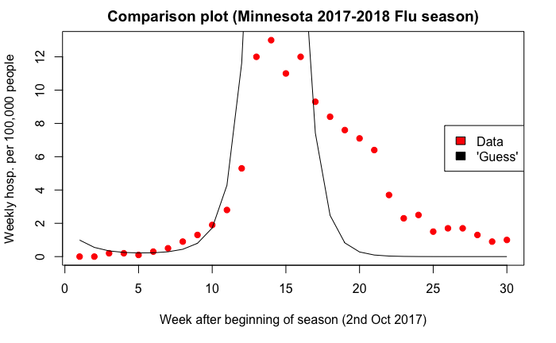
Prediction of the guessed parameters

Slide 14
The error/loss function
Our guess visually looked a poor match to the data. But how bad was it? Can it be improved upon?
A loss function measures the error between the data and the model prediction. It should be zero when the prediction and data match exactly, otherwise greater than zero.
Our goal is to find the parameters that minimize the least squares loss over the 30 weeks of data.
This loss function can be derived from the theory of normal errors for large numbers of independent events, this connects loss minimization to maximum likelihood estimation.

Slide 15
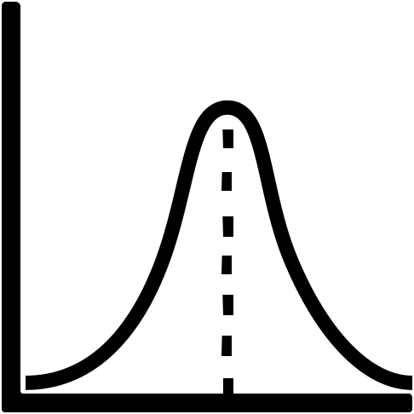
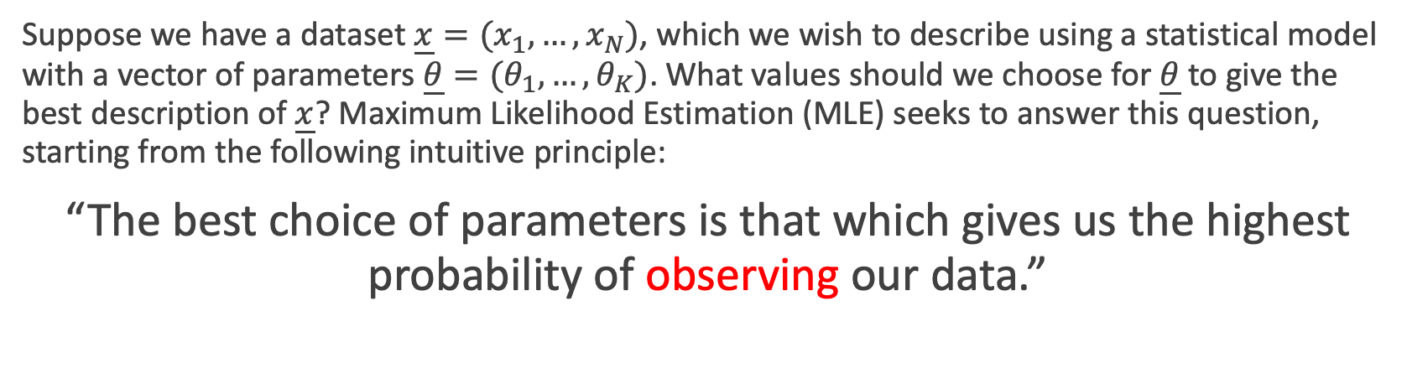
Maximum Likelihood Estimation recap
Suppose we have a dataset $\underline{x}=(x_{1},…,x_{N})$, which we wish to describe using a statistical model with a vector of parameters $\underline{θ}=(θ_{1},…,θ_{K})$. What values should we choose for $\underline{θ}$ to give the best description of $\underline{x}$? Maximum Likelihood Estimation (MLE) seeks to answer this question, starting from the following intuitive principle:
“The best choice of parameters is that which gives us the highest probability of observing our data.”
In this workshop we will consider Normally distributed errors around the model mean prediction
Prediction (mean)
Prediction (variance)

Slide 16
Try yourself…
What is the variance of the weekly flu hospitalization prediction? Can we connect this to Poisson regression?

Slide 17
Numerical Optimization: Local optimization
Local optimizer methods look for the local points to the current estimate which have lower loss, and move in the direction of fastest improvement (this often involves calculating a gradient for the loss function).
Sequential improvement
Loss surface

Slide 18
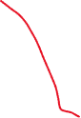
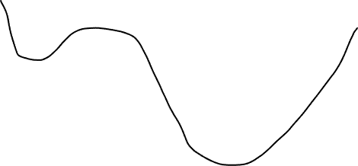

Numerical Optimization: Local optimization
The problem with local optimizers is that they can get stuck at local optima that are not good fits to the data.
Loss
This initial condition finds the global optimum
This initial condition gets stuck at a local minimum

Slide 19
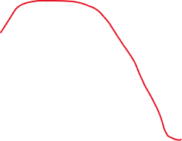
Numerical Optimization: Global optimization
There are multiple approaches to trying to find the global optimum. We use simulated annealing.
…until it finds it way out of the local minimum and converges to the global minimum.
Loss
This initial condition gets stuck at a local minimum…

Slide 20
Try yourself…
In the workshop RMD file we use a few different initial guesses for local optimization. Do some more! Can you find fitting improvements?
The simulated annealing method is known to be sensitive to “temperature”, try some different parameters.
The best fit point for the full model is on a boundary… this is very hard for optimizers to determine. Try varying the method used in the workshop RMD file to fit the full model and see if you can find a better point.

Slide 21
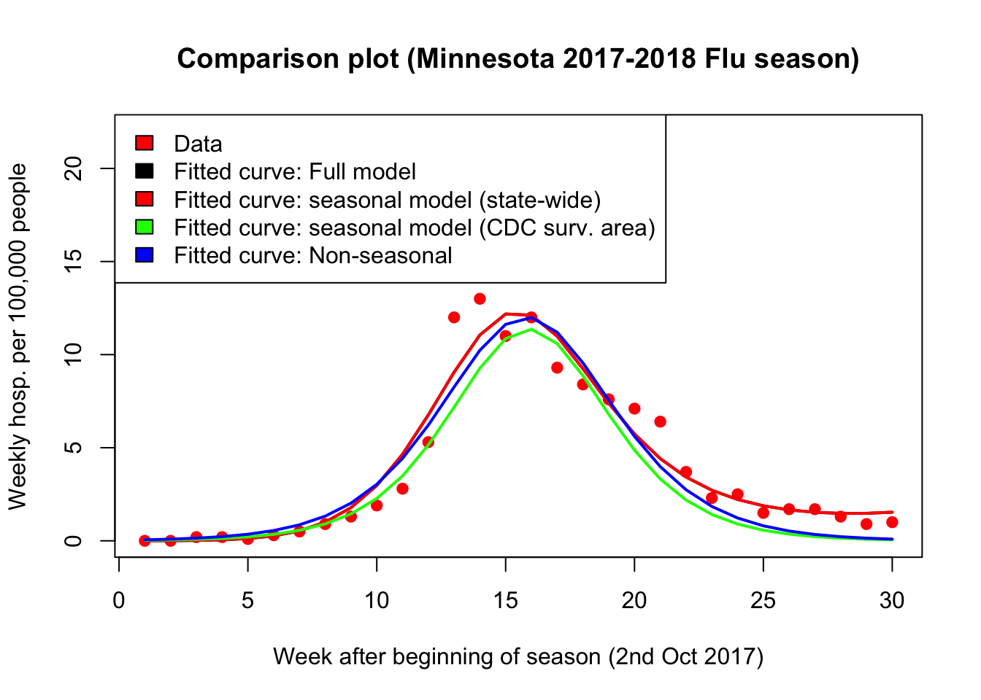
Best fits for the epidemic models

Slide 22
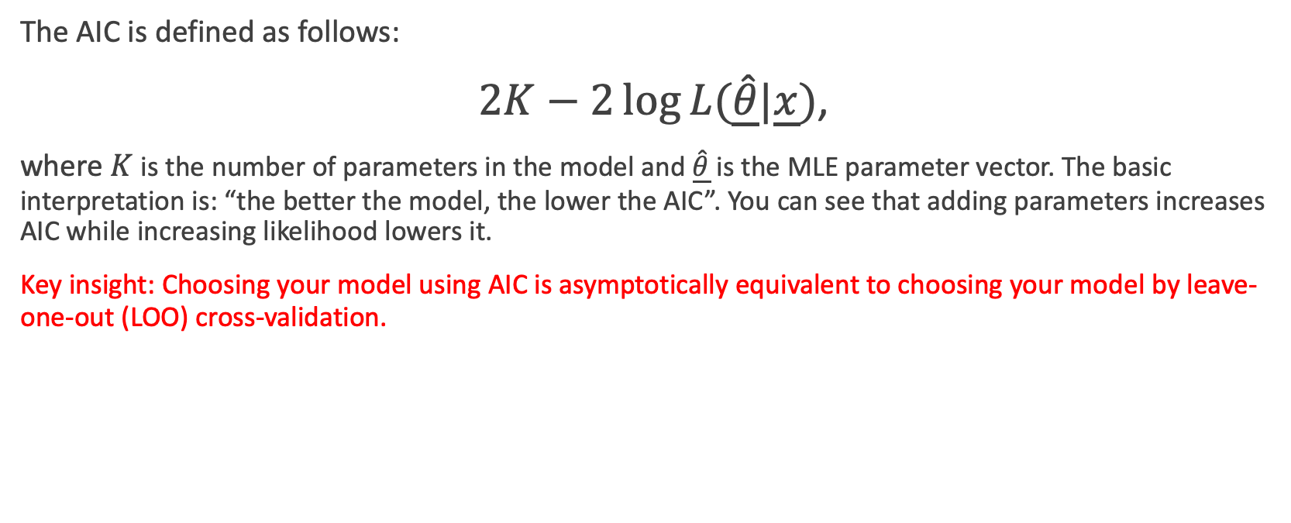
Model selection: AIC
The AIC is defined as follows:
$2K−2\log{L(\underline{\hat{θ}}|\underline{x}})$,
where $K$ is the number of parameters in the model and $\underline{\hat{θ}}$ is the MLE parameter vector. The basic interpretation is: “the better the model, the lower the AIC”. You can see that adding parameters increases AIC while increasing likelihood lowers it.
Key insight: Choosing your model using AIC is asymptotically equivalent to choosing your model by leave-one-out (LOO) cross-validation.

Slide 23
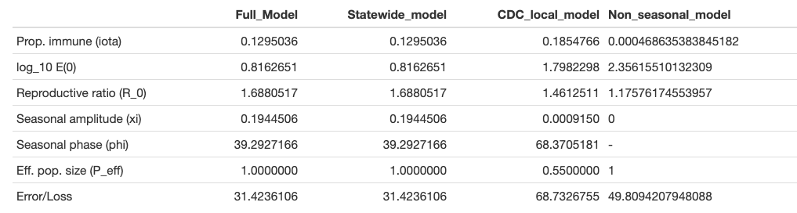
Model selection: How did the models perform?

Slide 24
Model selection
We can see that the State-wide seasonal model is better than the either the full model or the CDC local model
Less free parameters
Same fit
State-wide
Same number of free parameters
Better fit
Full
CDC local
Non-seasonal

Slide 25
Model selection
However, the State-wide vs non-seasonal model has a tension between less complex and bettering fitting
State-wide
More free parameters
Better fit
Full
CDC local
Non-seasonal

Slide 26
Try it yourself…
The difference between the AIC scores for the non-seasonal and seasonal models is given above.
It depends on the prediction variance!

Slide 27
Model selection
This observation quantifies our intuition:
Hospitalizations per 10^5 people
Prefer the more accurate seasonal model
Hospitalizations per 10^5 people
Prefer the less accurate, but less parameterized non-seasonal model

Slide 28



NIHR Global Health Research Group project on the Application of Genomics and Modelling to the Control of Virus Pathogens (GeMVi) in East Africa at the University of Warwick
Funding statement: The research was commissioned by the National Institute for Health research using Official Development Assistance (ODA) funding.
Disclaimer: The views expressed are those of the author(s) and not necessarily those of the NHS, the NIHR or the Department of Health and Social Care.

